Slide 1

Audit data modelling / Semantic model for audit data services
JISC / SAMBUICHI, Nobuyuki (Nobu)
2021-06-23

Slide 2

ISO/TC 295 N 237 The recommendations regarding the Constitution and Terms of reference of Study Group
Title::
Semantic model for audit data services
Scope:
The study group will do the following works related with semantic model:
1. Identify the users of audit data
2. Identify the requirements of users
3. Discuss the general principles, such as complicated modeling or simple modeling, consistent and extensible, user-friendly and cost-effective
4. Decide the appropriate framework and method
5. Form the proposal of a new work project（TBD）
Model developing and maintenance are not included, but the requirements how to develop and maintain will be discussed and defined.
Membership:
5 experts at most for each P-member, experts from O-member and liaison are always welcome.
Convenor candidate:
Mr. Nobuyuki Sambuichi (JISC)
Shurong Wang
Committee manager of ISO/TC 295

Slide 3
ISO/IEC Directives, Part 2, 2018 4 Objective of standardization
The objective of documents is to specify clear and unambiguous provisions in order to help international trade and communication. To achieve this objective, documents shall:
• be complete within the limits specified by their scope;
NOTE 1 When a document provides requirements or recommendations, these are either written explicitly, or made by reference to other documents
• be consistent, clear and accurate;
• be written using all available knowledge about the state of the art;
• take into account the current market conditions;
NOTE 2 There is sometimes a tension between what is technically feasible and what the market actually requires and is prepared to pay for.
• provide a framework for future technological development;
• be comprehensible to qualified people who have not participated in their preparation; and
• conform to the ISO/IEC Directives, Part 2.
A document does not in itself impose any obligation upon anyone to follow it. However, an obligation can be imposed, for example, by legislation or by a contract which makes reference to the document.
A document shall not include contractual requirements (e.g. concerning claims, guarantees, covering of expenses) and legal or statutory requirements.

Slide 4
Understanding the prerequisites for ISO
1. Please take the time to read ISO/IEC Directives, Part 2, especially GENERAL PRINCIPLES 4 Objective of standardization, and answer how your current document meets these requirements. International Standards SHALL be drafted in accordance with the RULES given in the ISO/IEC Directives, Part 2.
2. Please elaborate in detail that your design meets our business requirements.
This page (https://www.sambuichi.jp/?p=4904&lang=en) is my opinion and we need to agree on the priority of our business requirements.
3. The Chinese national standard GB/T 24589.2-2010 for audit data collection is defined in XML Schema.
Again, please elaborate on the improvements in your XML design in terms of business requirement of ADCS.
They have been using this XML for decades and most accounting software, including Oracle, SAP and most of the software in China, which is certified (https://www.oracle.com/assets/psf9-gbt24589-2-2010-en-2614698-zhs.pdf).
We need to explain the design advantages over GB/T 24589.2-2010.
You can see my opinion about GB on this page (https://www.sambuichi.jp/?p=2860&lang=en).
4. Certification is required in China for the software to generate audit data. We should consider what kind of certification ADCS need and what to test and how, if we need certification.
Continued on the next page

Slide 5
Understanding the prerequisites for ISO
5. If you do not define an ADCS logical data model, there is an ISO standard framework MDR, MFI and MOF.
ISO 20022 (SWIFT) defined a meta model (part 1) and syntax mapping (part 4) using MOF. This is a standard way to define ISO documents.
Check excerpt page at https://www.sambuichi.jp/?p=4873&lang=en.
• ISO 15000-5:2014 Electronic Business Extensible Markup Language (ebXML) — Part 5: Core Components Specification
• ISO/IEC 19845:2015 Information technology — Universal business language version 2.1 (UBL v2.1)
• ISO/IEC 11179, Information technology — Metadata registries (MDR)
• ISO/IEC 19763, Information technology — Metamodel framework for interoperability (MFI)
• ISO/IEC 19502:2005 Information technology — Meta Object Facility (MOF)
• ISO 20022 Financial services — Universal financial industry message scheme Part 1: Metamodel, Part 4: XML Schema generation
6. Registration Authorities and/or Maintenance Agencies
Last but not the least, ISO/TC 68 Financial Services has RAs and MAs to support frequent updating to elements (https://committee.iso.org/sites/tc68/home/articles/content-left-area/articles/add-a-post-2.html).
The common ISO method is that it defines the ISO standard documentation for the design framework, and the implementation of standard elements is updated in a timely manner by RA and/or MA. We should consider RA and/or MA.

Slide 6

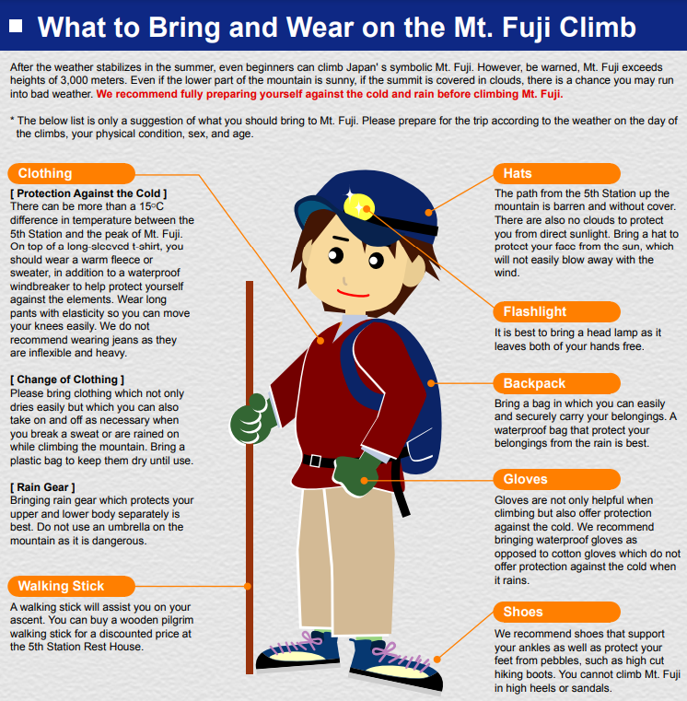
Things to consider before writing a standard Don’t climb mountain (ISO) in high heels
It is advisable to study history of the standard and be well prepared.
Colorado hiker climbs Mount Elbert in high heels
“A hiker in the US is proving no mountain is too tough, by throwing away her boots and replacing with a pair of heels instead. “
Kenneth Garger, New York Post OCTOBER 23, 2020 9:24AM
Even if it looks strange in the city, this is the clothes that safely reach the summit within the scheduled time.

Slide 7
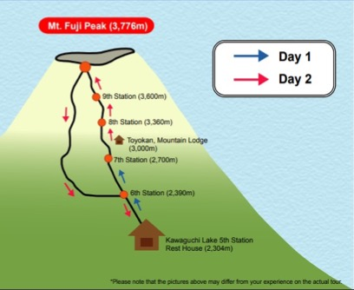
Standing on the shoulders of giants
Essential carry-on items
CCTS, UN/CEFACT CCL, UBL and XBRL
Day 1 Semantic modeling is defined based on following standards:
1) CCS (CCTS) defined in ISO 15000-5 Electronic Business Extensible Markup Language (ebXML) -- Part 5: Core Components Specification (CCS);
2) Business rule definition for Core Invoice Usage Specification (CIUS) in EN 16931-1 Electronic Invoicing - Semantic data model of the core elements of an electronic invoice; and
3) Business process modeling in UBL
4) Extensible Business Reporting Language (XBRL) 2.1. Business rules can be validated using formula linkbase defined in taxonomy.
Day 2 We are standing on the shoulders of giants and defining new standards for new business domains for audit.
ISO/TC 295 Audit data services
Semantic modeling as a lodge on the first day
NOTE1: We have been wandering at the foot of this mountain for five years already.
We can't afford to spend more time looking for a trailhead. Follow the route they climbed.
NOTE2: Wikipedia says that it is a metaphor of dwarfs standing on the shoulders of giants and expresses the meaning of "discovering truth by building on previous discoveries".
Its most familiar expression in English is by Isaac Newton in 1675: "If I have seen further, it is by standing on the shoulders of Giants.“
ISO 21378:2019 Audit data collection

Slide 8
History of Standard Formats
91
17
EUROPEAN COMMITTEE FOR STANDARDIZATION
CEN: COMITÉ EUROPÉEN DE NORMALISATION
EN 16931-1:2017Electronic invoicing - Part 1: Semantic data model of the core elements of an electronic invoice
The Vienna Agreement
Agreements between standards bodies
CEN/TS 16931-3-2:2017 Electronic invoicing – Part 3-2: Syntax bindings for ISO/IEC 19845 (UBL 2.1) invoice and credit note
Memorandum of Understanding between IEC, ISO and UN/ECE
MoU on electronic business between IEC, ISO, ITU and UN/ECE
CEN/TS 16931-3-3:2017 Electronic invoicing – Part 3-3: Syntax bindings for UN/CEFACT XML Industry Invoice D16B
OASIS joined above
SGML Open
93
98
02
04
06
13
16
18
20
21
OASIS Open
Universal Business Language v1.0
UBL v2.1
UBL v2.2
UBL v2.3
UBL v2.0
UBL Naming and Design Rules
UBL Naming and Design Rules v3.0
Business Document Naming and Design Rules (BDNDR) v1.0
BDNDR v1.1
94
00
02
03
06
16
UNECE
UN/CEFACT
Core Component Technical Specification (CCTS)
Core Component Library (CCL) 06A
CCL 16B
91
94
00
02
05
14
15
19
ISO
ISO 21378:2019 Audit data collection
Birth of the Internet
ISO/TS 15000-5:2005 Electronic Business Extensible Markup Language (ebXML) — Part 5: ebXML Core Components Technical Specification, Version 2.01(ebCCTS)
91
95
ISO 15000-5:2014 Electronic Business Extensible Markup Language (ebXML) – Part 5: Core Components Specification (CCS)
HTTP0.9
HTML2.0
ISO/IEC 19845:2015 Universal Business Language v2.1
W3C
94
00
01
04
10
12
14
20
XML 1.0 (Second Edition)
JSON-LD 1.0
JSON-LD 1.1
XML Schema 1.0
XML Schema 1.0 (Second Edition)
XMLSchema Definition Language (XSD) 1.1
XFRML
XML Linking Language (XLink) 1.0
XML Linking Language (XLink) 1.1
XBRL
98
00
01
02
03
06
07
09
10
21
XBRL Specification 1.0
XBRL Dimensions 1.0
Open Information Model 1.0
XBRL Specification 2.0
XBRL Formula 1.0
XBRL Specification 2.0a
XBRL Inline 1.0
XBRL Specification 2.1
XBRL GL taxonomy 1.21
XBRL Global Ledger Framework

Slide 9
Business Requirements
Reduce, Reuse and Recycle is the key concept of SDGs Avoid Not-invented-here syndrome (NIH). NIH can be defined by a tendency for people and organizations to avoid things that they didn’t create themselves. This syndrome is similar to the “let’s reinvent the wheel” syndrome. [SOURCE: https://www.bmc.com/blogs/not-invented-here-syndrome/ ]
Business Process Now that we have extended the TC name to audit data services, we should support not only data modeling but also business processes, business rules, and these validation.
Extensibility Organizations in each jurisdiction have regulations and / or internal control rules for each jurisdiction. We SHALL supports extensibility to meet these requirements.
Comparability There are many things in common other than the expansion due to the jurisdiction differences. We SHALL support comparability based on common points.
Localization As an international standard, we SHALL support localized labeling and description in the natural language of the jurisdiction.

Slide 10
Q & A

